Slide 1


Project Stakeholders Presentation: Comparing Cost & Time Performance Of The Projects.
Target Stakeholder Group: Program (Cross - Project) Leaders.

Slide 2
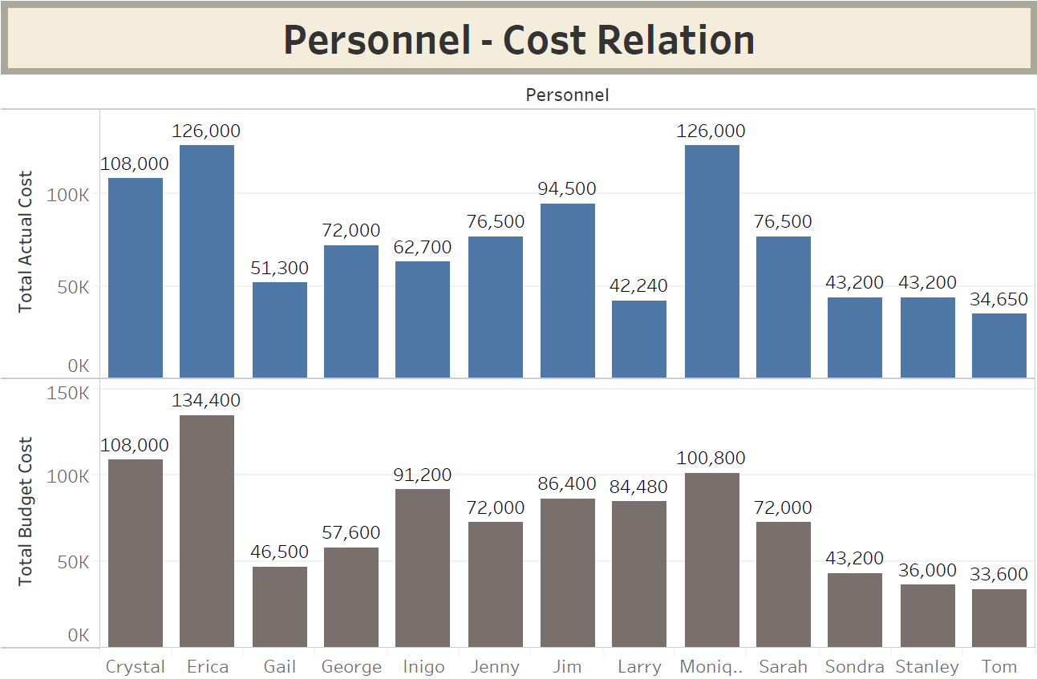
Analysis:
As seen from this Chart:
Gail, George, Jenny, Jim, Monique, Sarah, Stanley and Tom Went Over the Budget in This 6 Months Project(s) Span.
Erica, Inigo & Larry Completed There tasks While Staying In the Budget.
Crystal & Sondra Utilized Their Entire Budget.
The Personnel With Who Went Over The Limit May Also Have Worked Overtime or Might Be Charging More Per Hours Than Average.
This Also Affects The 40hr/week Schedule of The Employees.

Slide 3
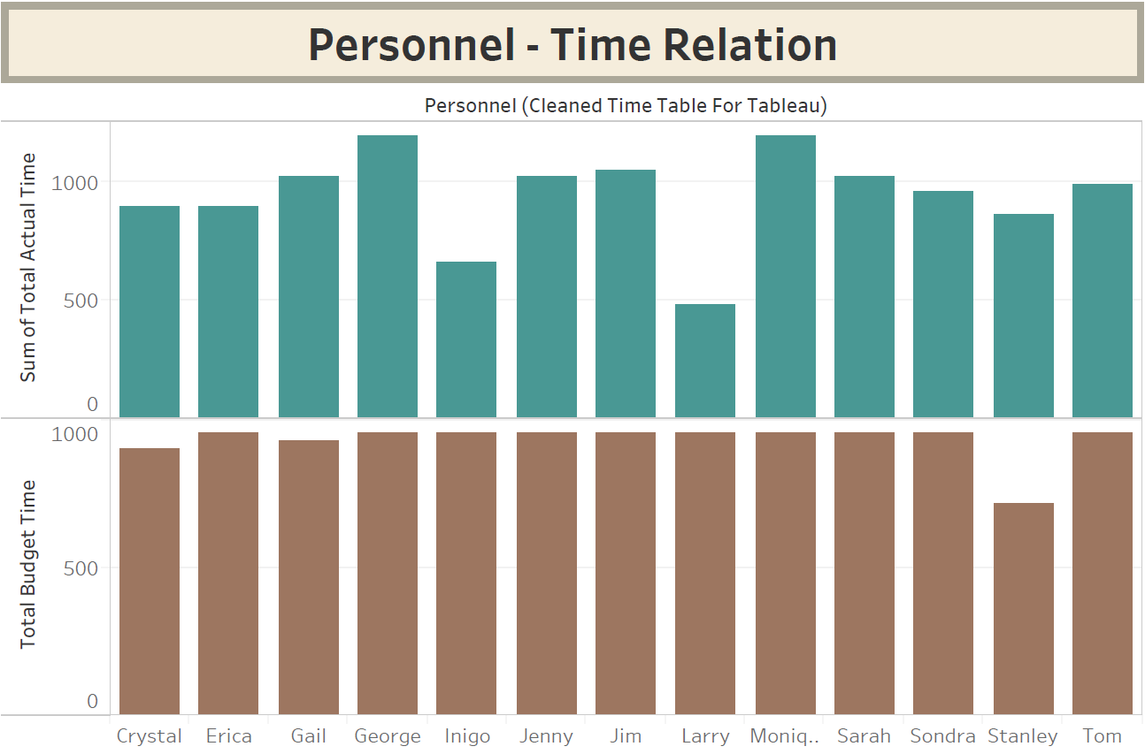
Analysis:
As seen from this Chart:
In the Span of 6 Months, Crystal, Erica, Inigo, Larry and Sondra were able to complete their work on time.
Gail, George, Jenny, Jim, Monique, Sarah, Stanley and Tom were behind their Schedule.
Projects Getting Completed on time is essential for the company, while those Project(s) which took longer are not that far off the mark.

Slide 4
Observations:
Projects B, D, and E are developing new digital financial products that are expected to generate revenue for JPMorgan Chase & Co.
Projects B and D are on schedule, Project E is at risk for falling behind but is currently still roughly on schedule.
Projects A and C are internal efforts at process improvement for cost reduction.
Project A is on schedule, Project C is well behind schedule and at risk for failure.
Giving some more time to the Projects which are behind the Allotted time can make a difference.
The teams are Doing their best, although In between a creative activity may boost their morale and efficiency.

Slide 5
Summary:
Revision of the Personnel – Project / Personnel – Time for the Failing Projects.
Providing Some Guidance and Morale Boosting to Increase Efficiency.
Creating Small Sub teams To Decrease Workload.

